Slide 1


Data Structures
ETCCDS202
Dr. Aarti
Faculty
School of Engineering & Technology
K.R. Mangalam University
Unit 2 : Linear Data Structures

Slide 2

Unit-2 Linear Data Structures
SESSION 11 Arrays – 1D & 2D
SESSION 12 Static & Dynamic Arrays
SESSION 13 Linked Lists Types
SESSION 14 Linked List Operations
SESSION 15 Stack ADT & Operations
SESSION 16 Stack Applications
SESSION 17 Queue ADT
SESSION 18 Queue Applications
SESSION 19 BFS using Queue
SESSION 20 Revision (Unit–2)
Notes:
New Courses replaced with New Programmes

Slide 3
Arrays – 1D & 2D
Session 11
Concept of Arrays
Need and Advantages of Arrays
Array Terminologies
Declaration and Initialization of Arrays
Accessing Array Elements
One-Dimensional Arrays (1-D Arrays)
Two-Dimensional Arrays (2-D Arrays)
Practice Problems and MCQs
Key Takeaways
Notes:
New Courses replaced with New Programmes

Slide 4
Learning Objectives
After this lecture, students will be able to:
Define an array and explain its characteristics
Declare, initialize, and access 1-D arrays
Understand the structure and usage of 2-D arrays
Apply arrays to solve simple computational and real-world problems
Notes:
New Courses replaced with New Programmes

Slide 5
Recapitulation (Unit-1: Data Structures & ADTs)
Data Structures: Way to store, organize, and manage data efficiently
Helps in fast access, insertion, deletion, and processing
Need for Data Structures
Efficient data handling
Better performance and reduced complexity in programs
Abstract Data Types (ADTs)
ADT defines what operations are performed, not how
Focuses on behavior and functionality
Notes:
New Courses replaced with New Programmes

Slide 6
Recapitulation (Unit-1: Time & Space Complexity)
Time Complexity: Measures how execution time grows with input size
Space Complexity: Measures memory usage of an algorithm
Case Analysis: Best Case, Average Case, Worst Case
Common Time Complexities
O(1) → Constant time, O(log n) → Logarithmic
O(n) → Linear,
O(n log n), O(n²), O(2ⁿ), O(n!)
Notes:
New Courses replaced with New Programmes

Slide 7
Recapitulation (Unit-1: Algorithm Design & Recursion)
Divide & Conquer: Divide problem → Solve subproblems → Combine results
Greedy Algorithm: Makes locally optimal choices but may not give global optimum solution.
Dynamic Programming: Solves overlapping subproblems
Used when Greedy fails
Recursion: Function calling itself
Uses call stack to store function calls
Notes:
New Courses replaced with New Programmes

Slide 8
Recapitulation (Unit-1)
Q1. Which best defines a data structure? a) Programming language b) Method of organizing data c) Operating system d) Algorithm
Q2. Which of the following is an ADT? a) Array b) Stack c) Pointer d) Variable
Notes:
New Courses replaced with New Programmes

Slide 9
Recapitulation (Unit-1)
Q3. Which notation represents the worst-case complexity? a) Θ b) Ω c) O d) n
Q4. Time complexity of linear search in worst case is: a) O(1) b) O(log n) c) O(n) d) O(n²)
Notes:
New Courses replaced with New Programmes

Slide 10
Recapitulation (Unit-1)
Quiz (Answers)
Q1: b) Method of organizing data
Q2: b) Stack
Q3: c) Big-O (O)
Q4: c) O(n)
Notes:
New Courses replaced with New Programmes

Slide 11
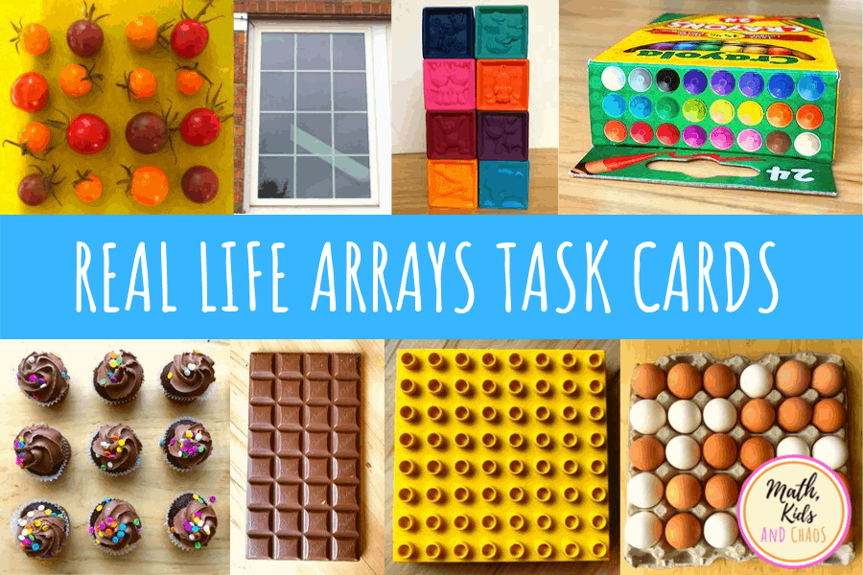
What is an Array?
An array is a collection of elements of the same data type
Elements are stored in contiguous memory locations
Fig.1: Examples of Array
Notes:
New Courses replaced with New Programmes

Slide 12
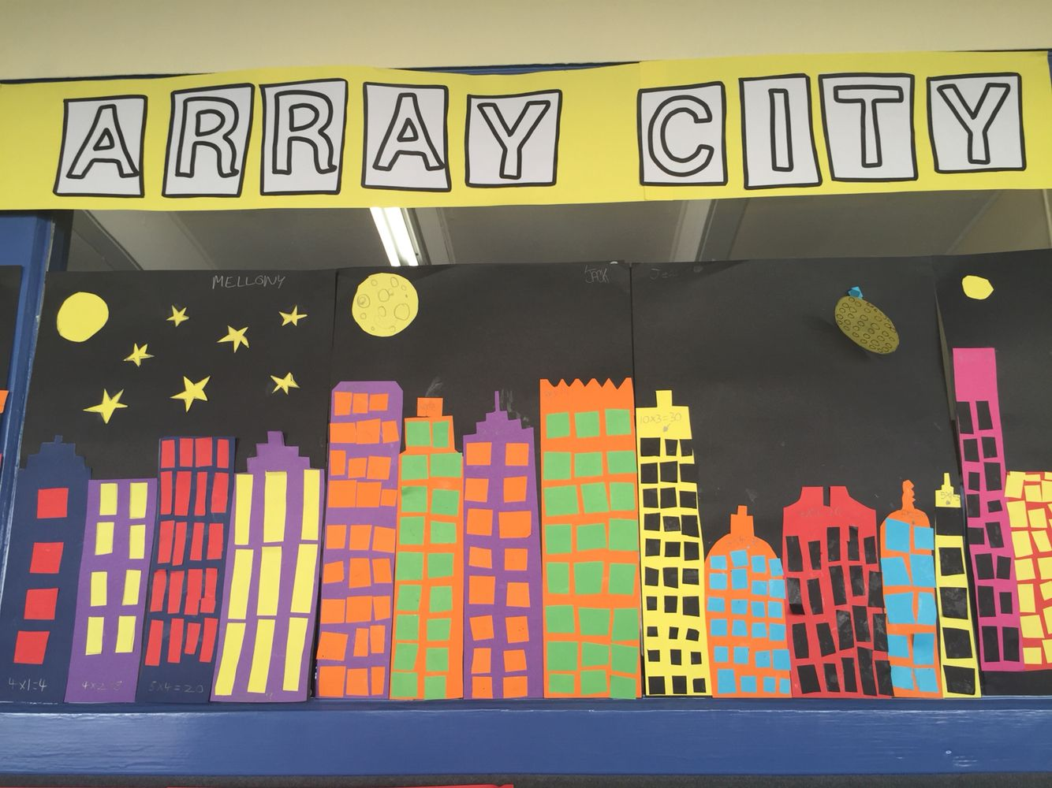
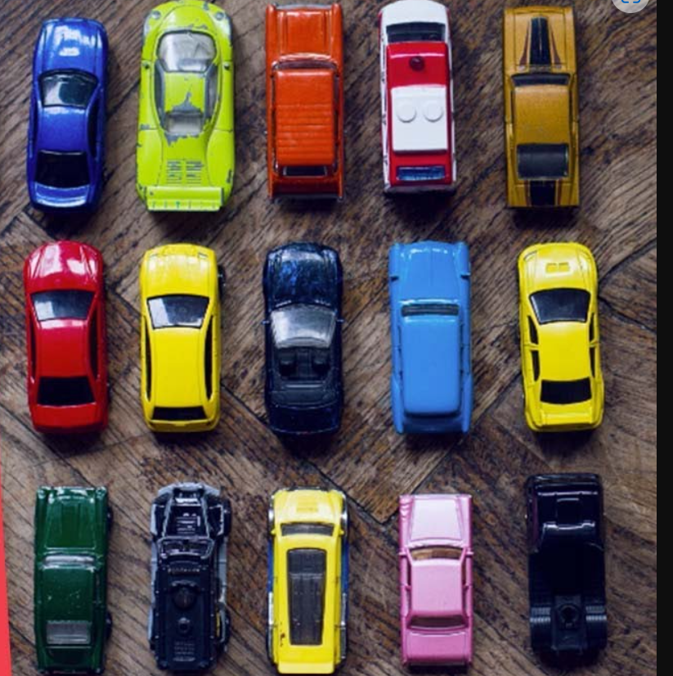
What is an Array? (Cont..)
Fig.2: Examples of Array
Notes:
New Courses replaced with New Programmes

Slide 13
Why Arrays are Used?
Efficient storage: Store multiple values using one variable name
Random Access: Easy access to data using an index
Iterative Operations
Reduces code length and complexity
Represent many instances in one variable
Notes:
New Courses replaced with New Programmes

Slide 14
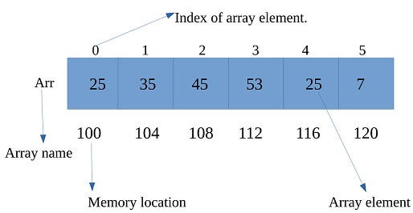
Indexing Concept
Linear data structure
Same data type elements
Contiguous memory allocation
Each element has an index number
Index usually starts from 0
Elements accessed using index value
Fig.3: Representation of an Array
Notes:
New Courses replaced with New Programmes

Slide 15
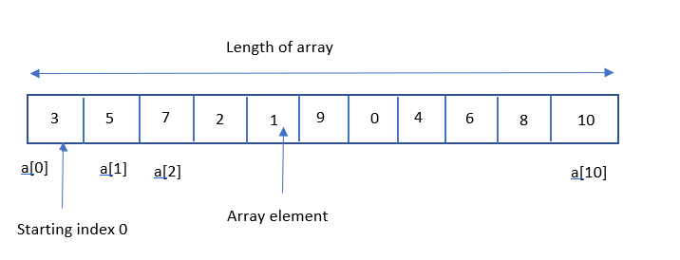
Test your knowledge
Ques: What is the length of the array shown in Figure?
Fig.4: Question on Array
Notes:
New Courses replaced with New Programmes

Slide 16
Basic Terminologies of array
Array Index - Each item in an array is indexed starting with 0. Each element in an array is accessed through its index.
Array Element - An array element is a single data item located at a specific index within an array.
Array Length - Array length is the total number of elements that an array can hold.
Notes:
New Courses replaced with New Programmes

Slide 17
Basic Terminologies of array
mylist = []
mylist.append(1)
mylist.append(2)
mylist.append(3)
print(mylist[0]) # prints 1
print(mylist[1]) # prints 2
print(mylist[2]) # prints 3
# prints out 1,2,3
for x in mylist:
print(x)
OUTPUT:
Notes:
New Courses replaced with New Programmes

Slide 18
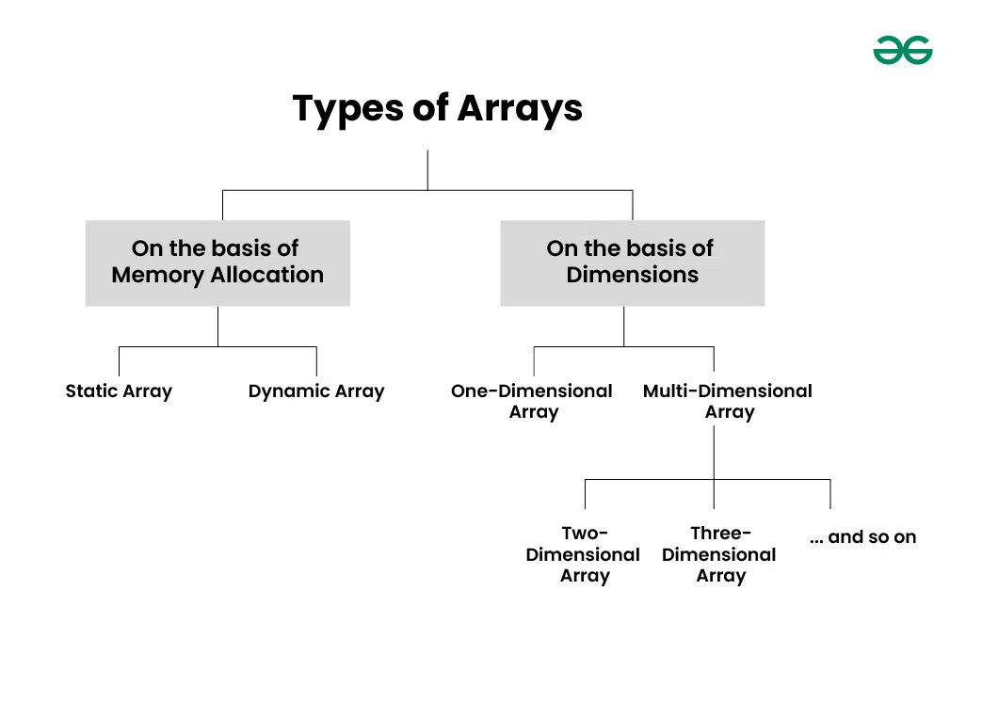
Classification of arrays
Fig.5: Types of Arrays
Notes:
New Courses replaced with New Programmes

Slide 19
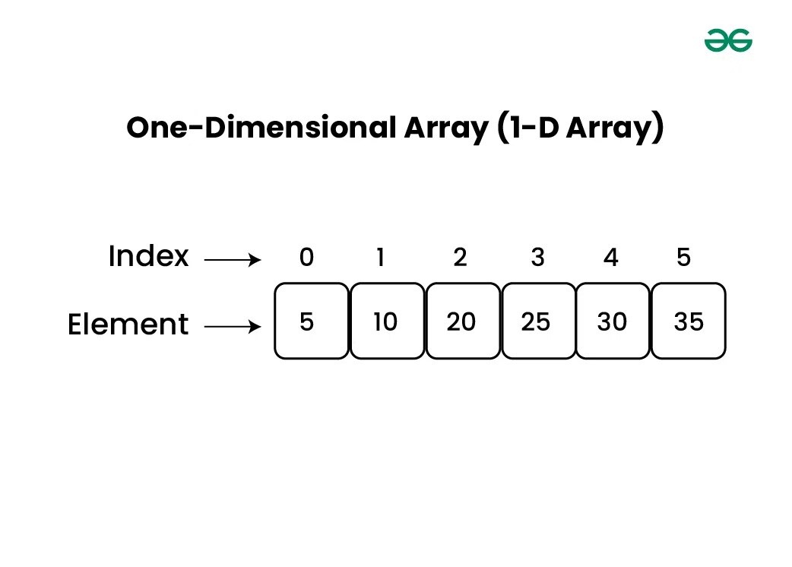
One-dimensional Array(1-D Array)
1-D as a row
Elements stored one after other.
Fig.7: Example of One-dimensional Array
Notes:
New Courses replaced with New Programmes

Slide 20
One-dimensional Array(1-D Array)
# This line creates a 1-D array (list) named numbers with five integer elements.
numbers = [10, 20, 30, 40, 50]
# This statement accesses the element at index 2 of the list.
print(numbers[2])
OUTPUT:
30
Index Explanation
numbers[0] = 10
numbers[1] = 20
numbers[2] = 30
Notes:
New Courses replaced with New Programmes

Slide 21
One-dimensional Array(1-D Array)
# Declare and initialize a 1D array (list in Python)
numbers = [10, 20, 30, 40, 50]
sum = 0 # Variable to store the sum of the array elements
# Loop through the list
for i in range(5):
sum += numbers[i] # Add each element to sum
# Output the sum of the array elements
print("Sum of the array elements is:", sum)
OUTPUT:
Sum of the array elements is: 150
Notes:
New Courses replaced with New Programmes

Slide 22
Quick Check
What is the index of the first element of an array?
How many elements are there in the array [5, 10, 15]?
Predict the output:
arr = [1, 2, 3]
print(arr[1])
Identify the Error
arr = [1, 2, 3]
print(arr[3])
Notes:
New Courses replaced with New Programmes

Slide 23
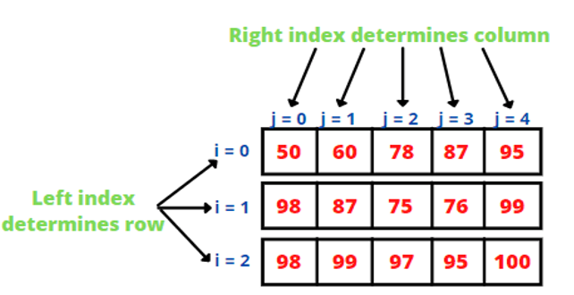
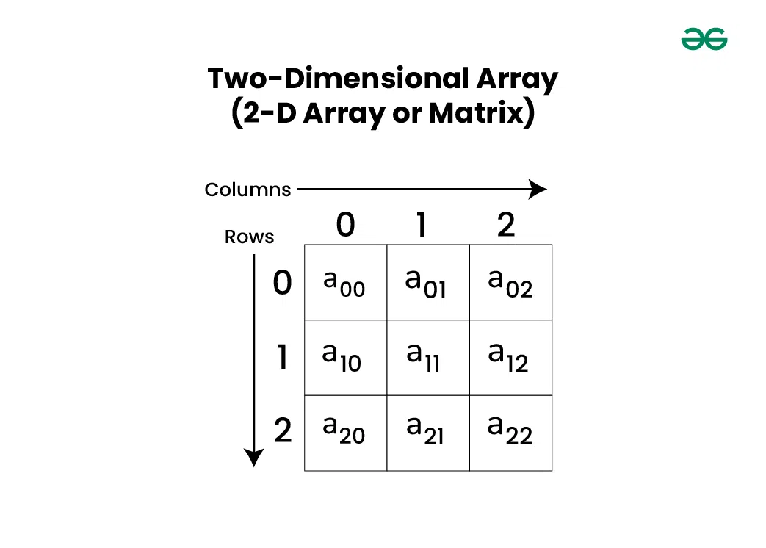
Two-dimensional Array(2-D Array)
Array of arrays
Consists of rows and columns
A 2-D array stores data in rows and columns
Also called a matrix
Fig.8 (a): Examples of Two-dimensional Array
Notes:
New Courses replaced with New Programmes

Slide 24
2-D Array Memory Layout
Rows and Columns
Rows → Horizontal
Columns → Vertical
Index Format
array[row][column]
Example:
matrix[1][2]
Fig.8 (b): Example of Two-dimensional Array
Notes:
New Courses replaced with New Programmes

Slide 25
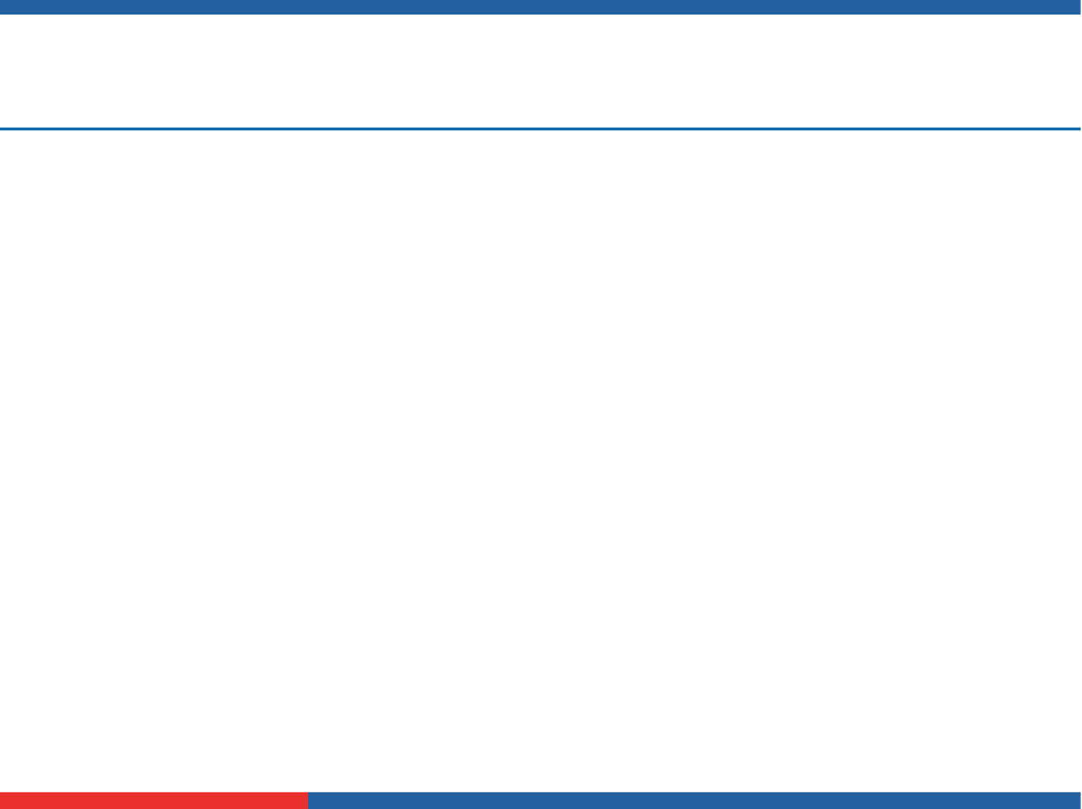
Worked Example – 2-D Array
matrix = [
[1, 2],
[3, 4]
]
#Traversal Using Loops
for i in range(2):
for j in range(2):
print(matrix[i][j])
OUTPUT:
1 2
3 4
Notes:
New Courses replaced with New Programmes

Slide 26
Worked Example – 2-D Array
matrix = [
[1, 2],
[3, 4]
]
matrix1= [
[1, 2],
[3, 4]
]
#Sum of Matrix Using Loops
for i in range(2):
for j in range(2):
print(matrix[i][j]+matrix1[i][j])
OUTPUT:
2
4
6
8
Notes:
New Courses replaced with New Programmes

Slide 27
Two-dimensional Array (2-D Array)
# Declare and initialize a 2D array (3x3 matrix)
matrix = [
[1, 2, 3],
[4, 5, 6],
[7, 8, 9]
]
# Declare a 2D array to store the transpose
transpose = [[0 for _ in range(3)] for _ in range(3)]
# Compute the transpose of the matrix
for i in range(3):
for j in range(3):
transpose[j][i] = matrix[i][j]
# Print the transpose matrix
print("Transpose of the matrix:")
for row in transpose:
print(row)
Transpose of the matrix:
[1, 4, 7]
[2, 5, 8]
[3, 6, 9]
Notes:
New Courses replaced with New Programmes

Slide 28
Quick Check
Q. Trace the Matrix
5 6
7 8
What is the value at matrix[1][0]?
What is the value at matrix[0][1]?
What is the value at matrix[1][2]?
Notes:
New Courses replaced with New Programmes

Slide 29
Practice Questions
Write a program to:
Store 5 elements in a 1-D array
Find their sum
Write a program to:
Add all elements of a 2-D array
Notes:
New Courses replaced with New Programmes

Slide 30
Key Takeaways (Summary)
1-D arrays store data in a single line
2-D arrays store data in rows and columns
Indexing usually starts from 0
Correct indexing avoids errors
Arrays make programs organized and efficient
Notes:
New Courses replaced with New Programmes

Slide 31
Situation- Based Questions
Q1 You are working on a scientific simulation that involves modeling weather patterns across a geographical area. Each grid cell in the simulation has various weather attributes, but many cells have default values due to the sparse nature of weather phenomena. Which type of array would you use to represent the weather data efficiently?
Q2 You are developing a game where players move around on a game board represented by a grid. Each cell in the grid can either be empty or contain an obstacle. How would you represent this game board using arrays, and which type of array would be most appropriate?
Notes:
New Courses replaced with New Programmes

Slide 32
Situation- Based Questions (Answers)
A1: Sparse array, as it efficiently handles datasets with many default or empty values, which is common in weather simulations.
A2: 2D array, as it provides a grid-like structure that matches the layout of the game board.
Notes:
New Courses replaced with New Programmes

Slide 33
References
Textbooks
Cormen, T. H., Leiserson, C. E., Rivest, R. L., & Stein, C., Introduction to Algorithms, MIT Press.
Lipschutz, S., Schaum’s Outline of Data Structures with C++, McGraw-Hill Education.
Reference Books
Weiss, M. A., Data Structures and Algorithm Analysis in C++, 5th Edition, Pearson Education.
Skiena, S. S., The Algorithm Design Manual, 3rd Edition, Springer.
Online Resources
GeeksforGeeks, Arrays in Data Structures
https://www.geeksforgeeks.org/array-data-structure/
TutorialsPoint, Data Structures – Arrays
https://www.tutorialspoint.com/data_structures_algorithms/array_data_structure.htm
MIT OpenCourseWare, Introduction to Algorithms
https://ocw.mit.edu
Notes:
New Courses replaced with New Programmes

Slide 34
THANK YOU

